Slide 1

Flight Reservation System

Slide 2
Introduction:
The main objective of this project is to develop a Java-based web application that facilitates efficient and convenient flight reservations. This application, called the "Flight Reservation System," is designed to provide users with a seamless booking experience through a user-friendly interface that covers the aspects of registering users, login functionality, flight ticket booking, and updating.

Slide 3
Microservices:
User (Port:9991)
Admin (Port:8887)
Airport (Port:8889)
Schedule (Port:8890)
Booking (Port:8888)
Api gateway (Port:9000)

Slide 4
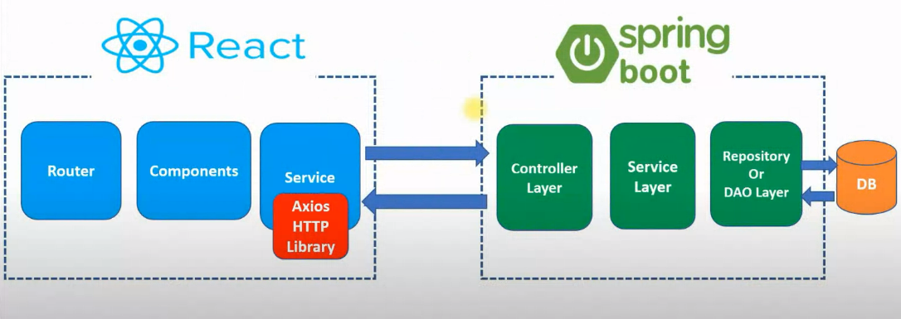
Architecture:

Slide 5
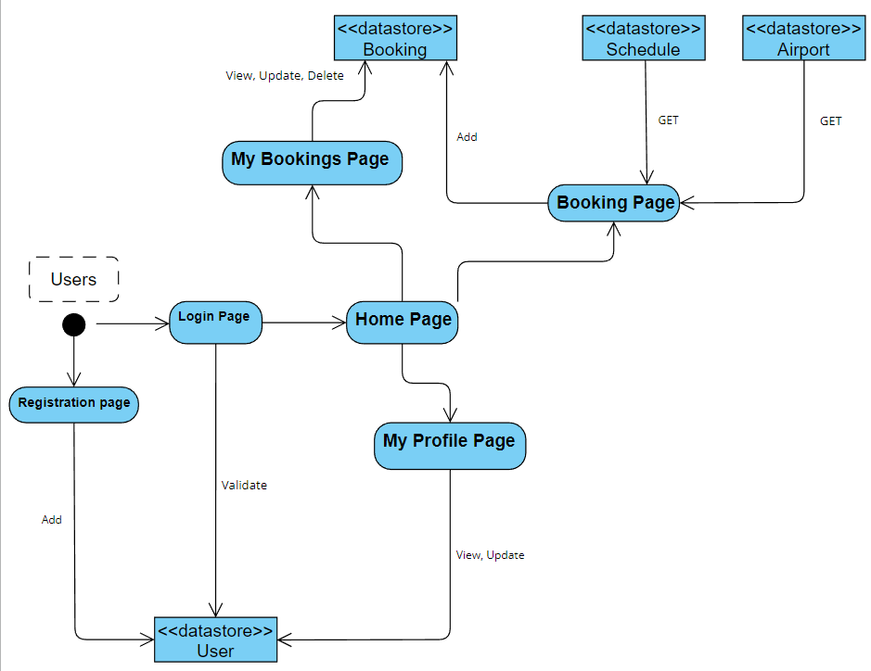
ER Diagram:

Slide 6
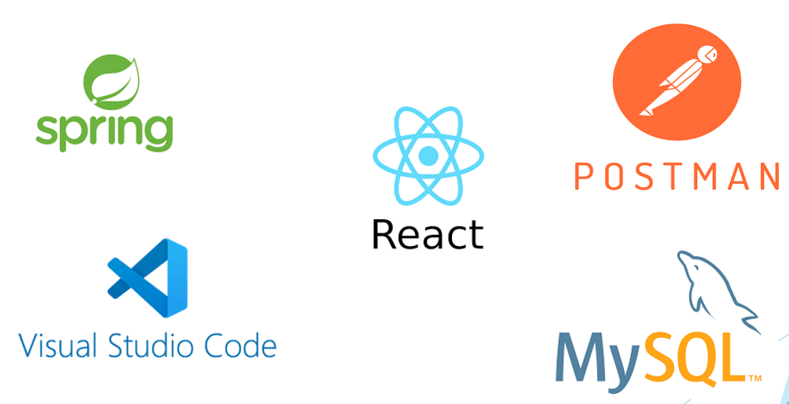
Tools:

Slide 7
Conclusion:
Overall, the Flight Reservation System is an innovative solution that simplifies the flight booking process and provides a seamless experience for users. With its efficient functionality and user-friendly interface, it has the potential to transform the way people book flights and make travel arrangements.

